Slide 1
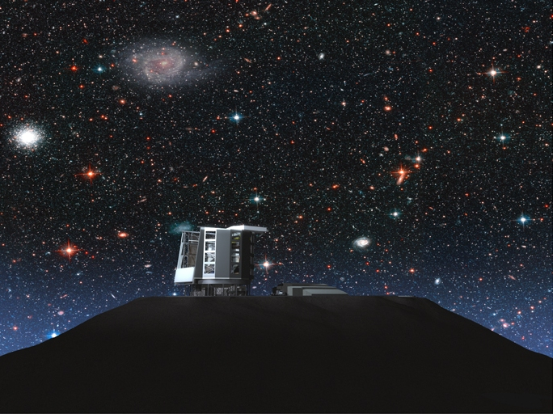
Testing a Dark Sector Interaction with GMT
Jounghun Lee (Seoul National University)

Slide 2
based on Lee (2010, arXiv:1008.4620)

Slide 3
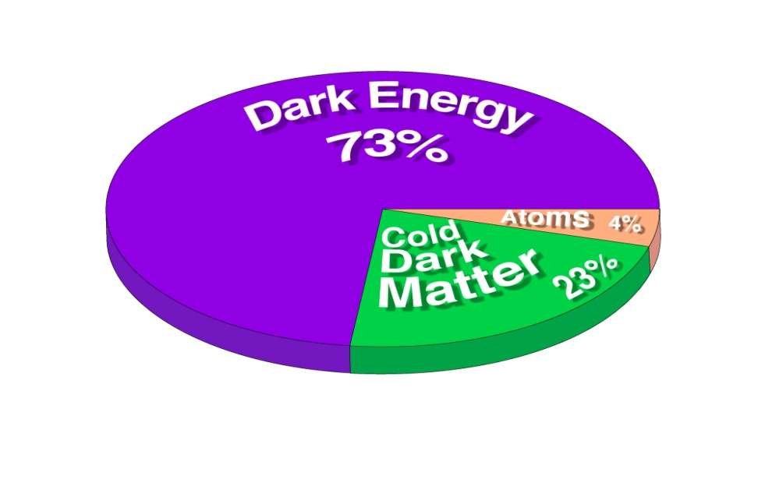
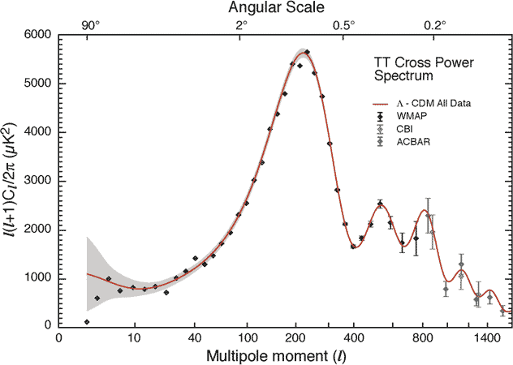
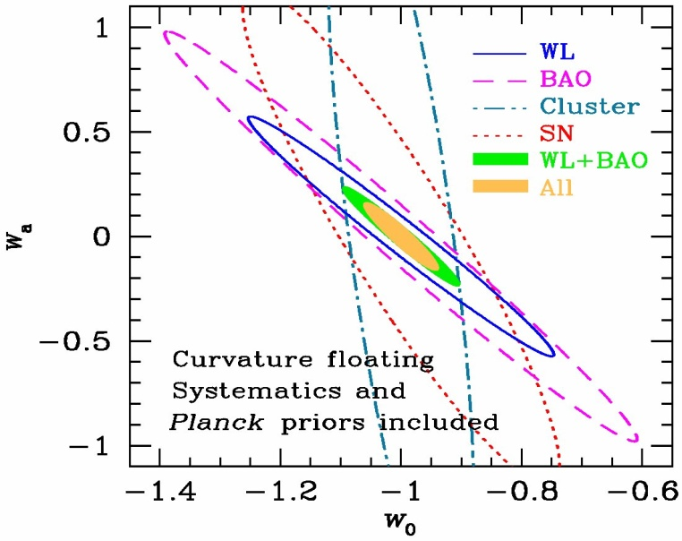
The ΛCDM Cosmology & Its Success

Slide 4
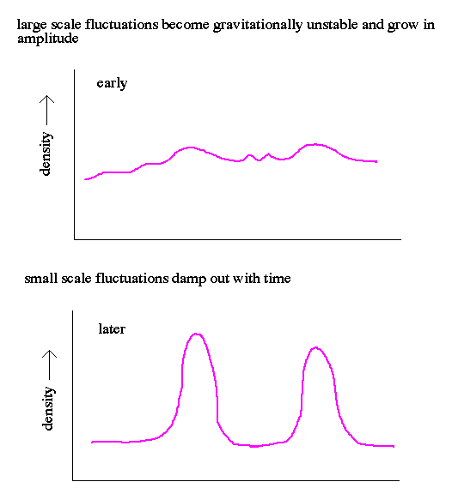
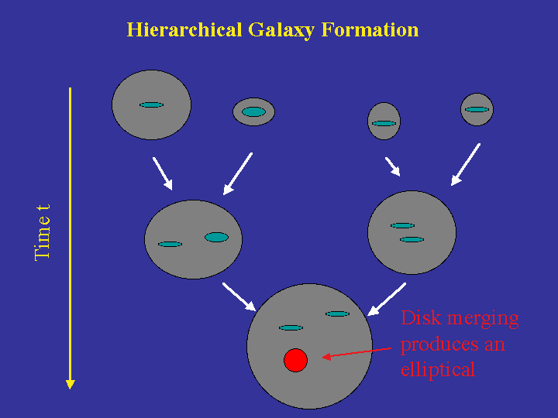
Structure Formation in a ΛCDM

Slide 5
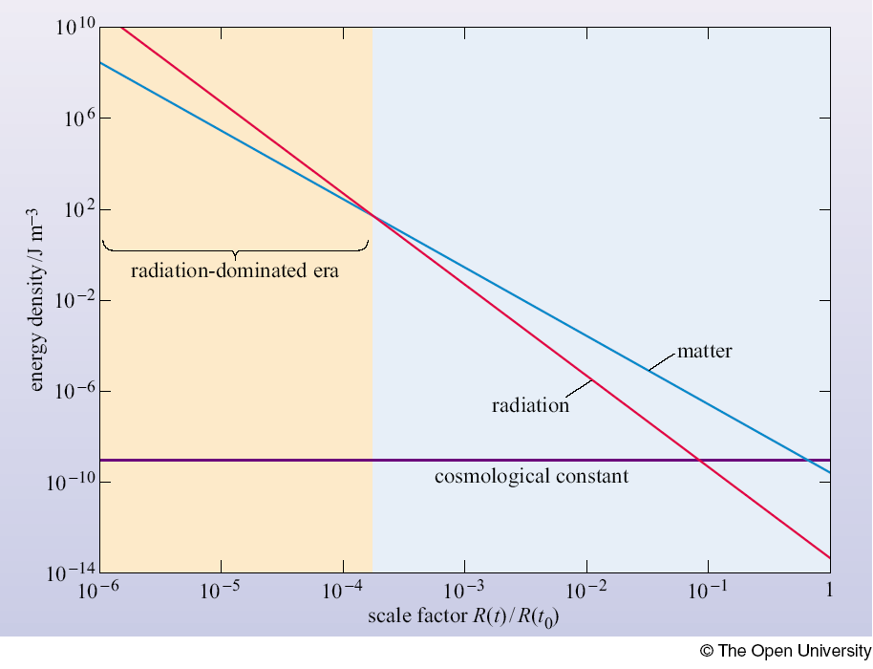
Unnaturalness of ΛCDM
Physical Problems:
  Fine-tuning of Λ
  The cosmic coincidence:
Cosmological Problem:
  Tensions with observations on Mpc scales

Slide 6
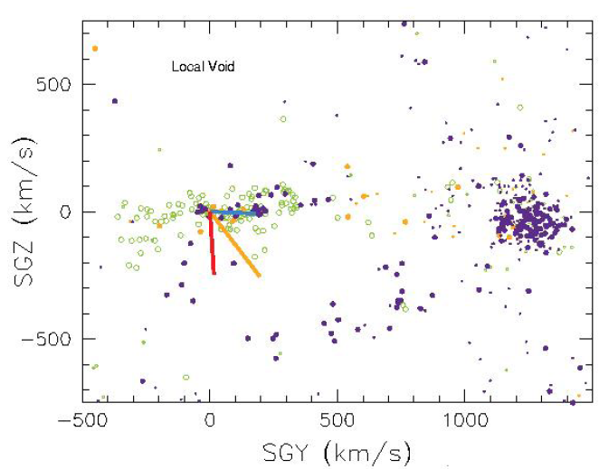
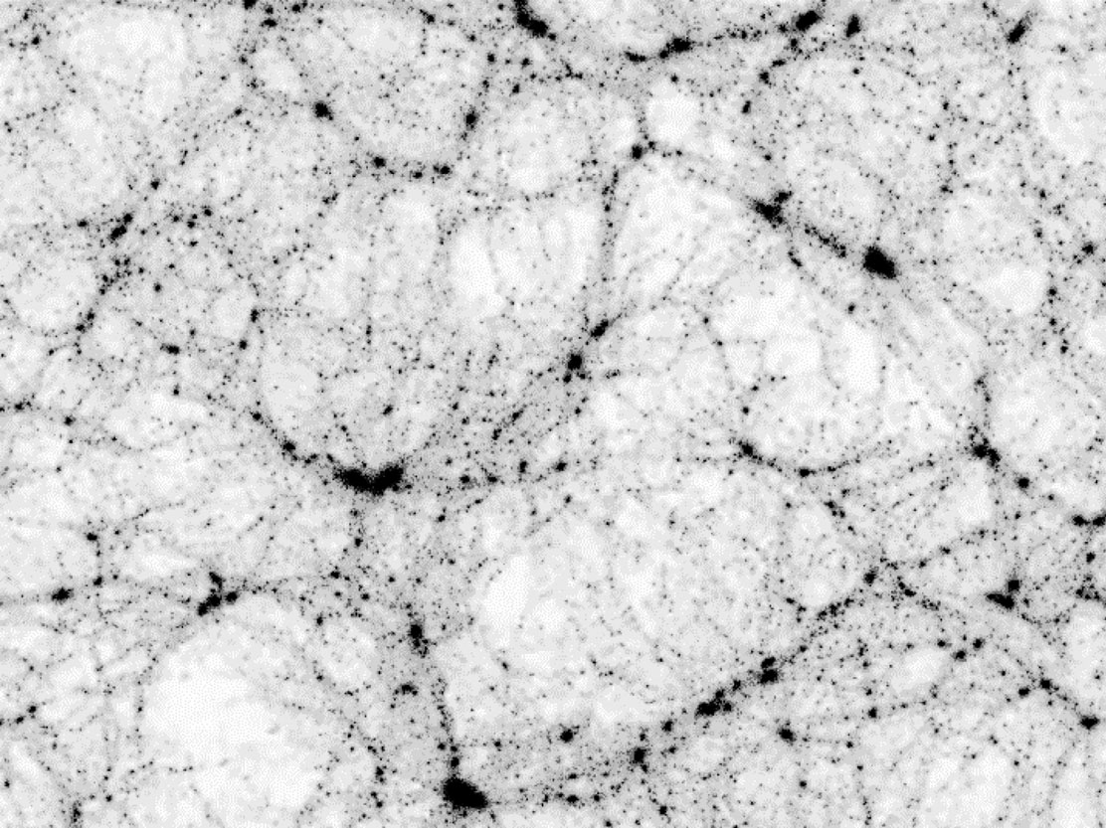
Tension 1: Emptiness of Voids
reality
ΛCDM
B.Tully (2007, IAU symposium)
In courtesy of virgo consortium

Slide 7
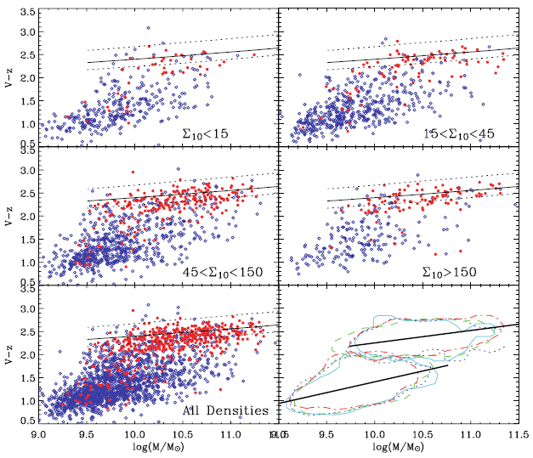
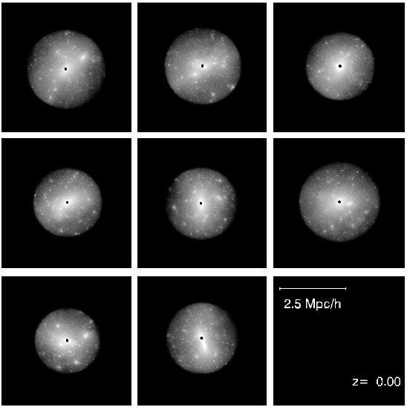
Tension 2: The Late Merging
reality
ΛCDM
Very stable color-magnitude
relation at z~0.7
On-going merging untill z~0
(Cassata et al. 2007, ApJS, 179, 217)
Gao et al. (2005, MNRAS,)

Slide 8
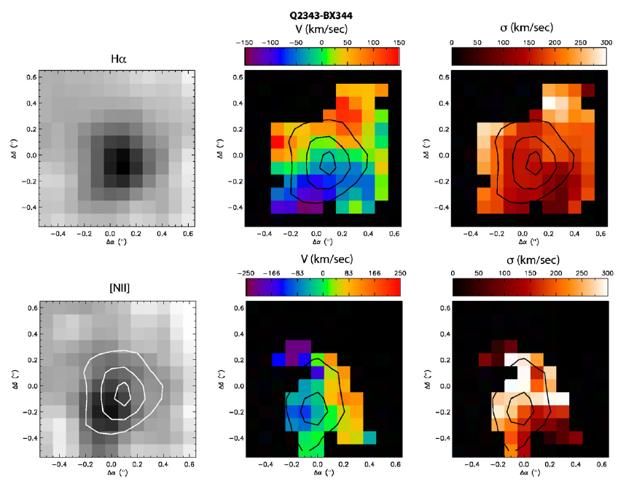
Tension 3: Population of High-z Disks
REALITY:
  A large fraction of the high-z galaxies (z~1) are well modeled as disks.
ΛCDM:
  Due to the high merging rate at z~1, the majority of the galaxies are ellipticals.
(Wright et al.2009, ApJ, 699, 421)

Slide 9
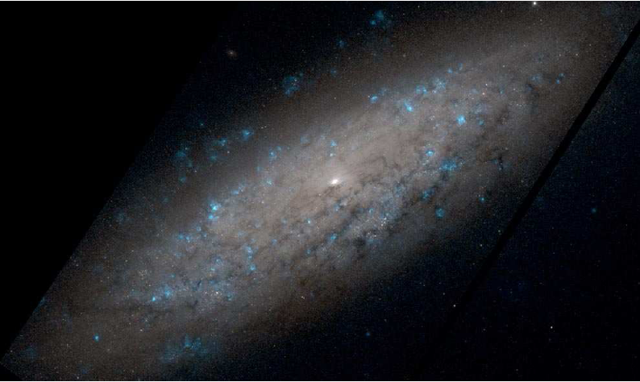
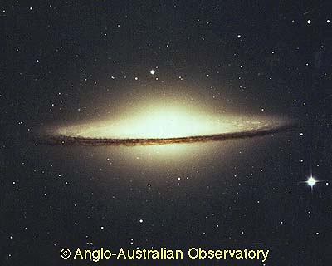
Tension 4: Bulgeless Giant Disks
REALITY:
  In the nearby field, 11 out of 19 giant galaxies are bulgeless disks.
ΛCDM:
  The majority of giant galaxies at z~0 have merger built-in bulges.
Kormendy et al. (2010, arXiv:1009.3015)

Slide 10
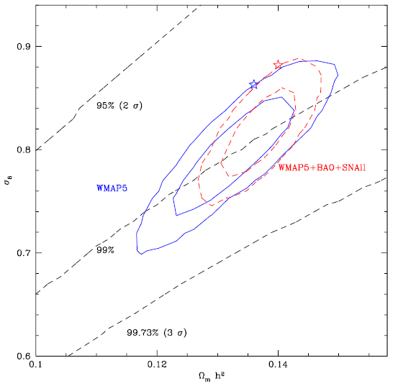
Tension 5: Large Scale Velocity Flow
REALITY:
  On r > 100 Mpc/h
ΛCDM:
  On r = 50 Mpc/h
Perivolaropoulors (2008, arXiv:0811.4684)

Slide 11
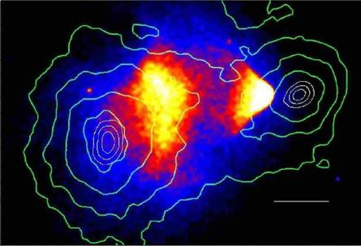
Tension 6: Speed of Bullet Cluster
REALITY
ΛCDM
Markevitch et al. (2004)
Springel & Farrar (2007)

Slide 12
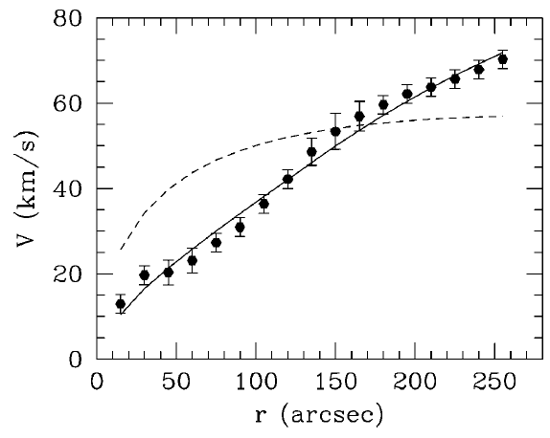
Tension 7: Galaxy Density Profile
REALITY:
  Constant flat cores
ΛCDM:
  universal NFW density
  cuspy core.
NFW
Burkert
Gentile et al. 2005, ApJ, 634, L145)

Slide 13
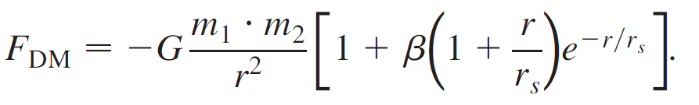
A Long-Range Scalar Interaction Model
An alternative to ΛCDM
Dark energy (DE) as a scalar field and dark matter (DM) as strings.
Long-range DE-DM coupling
An additional fifth force on DM particles.
Farrar, Gubser & Peebles (2005)

Slide 14
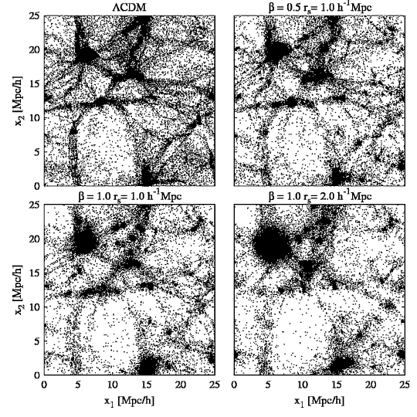
Structure Formation in LRSI
Earlier formation of dark halos.
Suppression of gas infall onto dark halos.
Elliptical galaxies as island Universe.
Evacuation of voids.
Hellwing & Juszkiewicz (2009, PRD, 80, 083522)

Slide 15
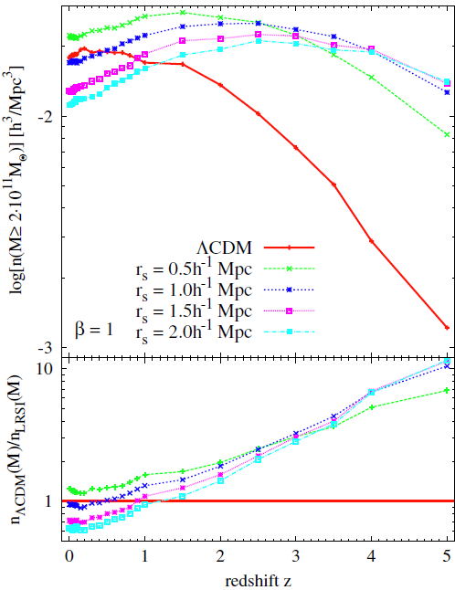
Previous Probes of LRSI
The cluster abundance
The N-point statistics
The weak lensing
The high-z supernovae
They all suffer from parameter degeneracy.
Hellwing & Juszkiewicz (2009)

Slide 16
Galaxy-Cluster Alignments
LRSI
ΛCDM
galaxy distribution
galaxy distribution
DM distribution
DM distribution

Slide 17
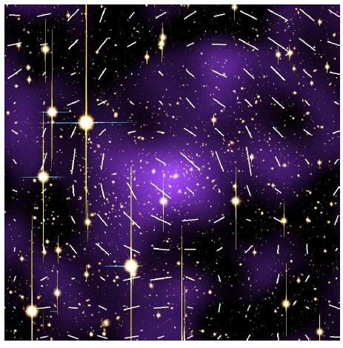
Observation Results
The orientations of dark matter distributions in clusters measured through weak lensing shear analysis.
The galaxy and matter distributions in clusters found be misaligned with each other.
A2390
Oguri et al.(2010, M NRAS, 405,2215)

Slide 18
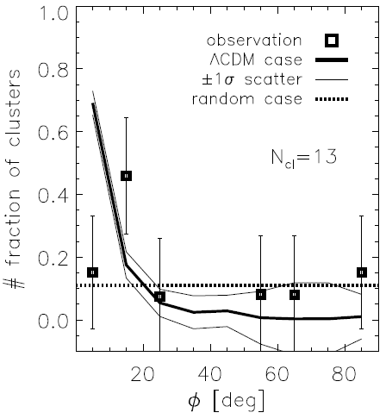
A Signature of Fifth Force?
The ΛCDM-based hypothesis is rejected at 95% confidence level.
Does it indicate the presence of a local fifth force as predicted by LRSI?
Or, is it merely due to some systematics?
Lee (2010, arXiv:1008.4680)

Slide 19
Summary & Ongoing Works
Galaxy-cluster alignments as a new independent probe of LRSI.
Construction of a more refined model for the galaxy-clusters (mis)-alignments in LRSI with the help of N-body simulations:
  (Lee, Baldi & Maccio in preparation).
A more thorough observational test against better data: (Lee et al. in preparation).

Slide 20
Prospects with GMT
GMT will allow us to understand the nature of the dark energy, which will in turn reveal the origin and final destination of the Universe!!

